Slide 1
Battle of Neighbourhood
Capstone Project
13/04/2020

Slide 2
Business Problem
Background
An international fashion chain, XYZ Limited has decided to open their first store in Asia and is considering Tokyo as a potential candidate, XYZ Limited want to establish the store as soon as possible.
Being the capital of Japan it offers a large potential customer base
A local population of 13.9 million people
31.2 million foreign tourist
The next Olympics will also be held in Tokyo
Client Criteria
The client has provided criteria to select the final district to maximise potential customers:
High density of local population
Large number of tourist
An established leisure suburb with entertainment venues that will draw visitors
An established shopping hub with fashion venues that will draw shoppers

Slide 3
Data sourcing and Wrangling
Data Sourcing
Two data source is sourced for this study
Tokyo local population demographic information by ward
Source: Wikipedia
Format: Web Scrap
Data at Date: 2016
Size: 8 Columns 24 Rows
Link: https://en.wikipedia.org/wiki/Special_wards_of_Tokyo
Tokyo Airbnb data by ward as approximation of tourist population
Source: Kaggle
Format: CSV file
Data at Date: 2019
Size: 14 Columns 11467 Rows
Link: https://www.kaggle.com/fuyutaro/tokyo-airbnb-open-data
Data Wrangling
Removed columns
Removed Total rows and Empty Rows
Cleaned funny characters within text columns

Slide 4
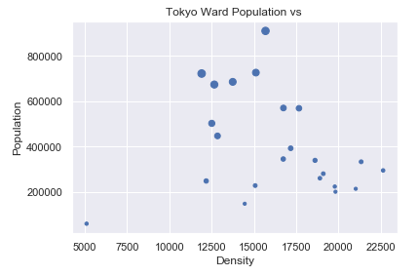
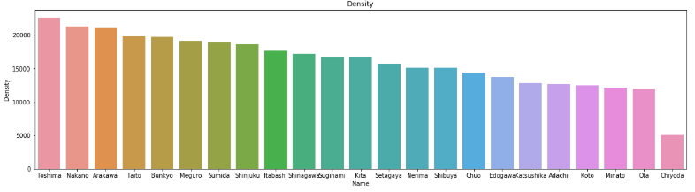
Population – potential customers
Analysis of file source 1 – Tokyo Ward Population
Analysis of the Ward Population data showed low correlation and no apparent trend, however we are able to identify the wards that can supply the highest local customers:
Toshima Ward
Nakano Ward
Arakawa Ward
Taito Ward

Slide 5
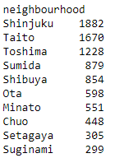
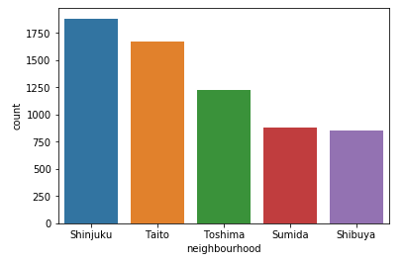
Population and density
Analysis of file source 2 – Tokyo Tourist Population
Summarization of the Tourist Population data shows the top wards that can supply the highest tourist customers:
Shinjuku Ward
Taito Ward
Toshima Ward
Sumida Ward
Taito and Toshima has appeared as top in both dataset

Slide 6
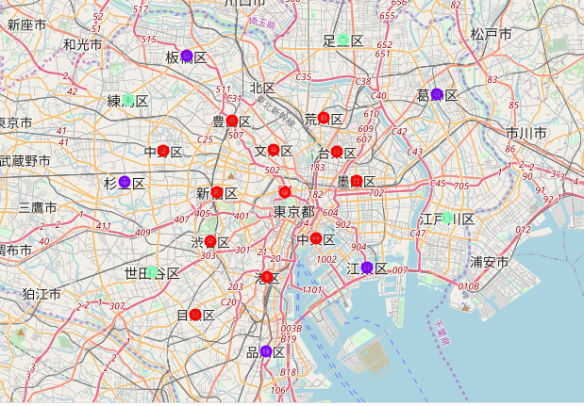
Selecting 3 wards
Joining the Datasets
Column | Definition
Cluster Label | Cluster number from k-means
Population | Local population in ward
Density | Population Density of ward
Area | Size in km^2 of ward
District | Names of district in ward
Ward Latitude | Latitude of ward
Ward Longitude | Longitude of ward
Count of Airbnb | Number of Airbnb situated within ward
Name of Ward | Name of the ward
To analyse all the variables, the datasets was joint on the ward name. The resulting 9 variable columns with 23 ward rows
Wards Demographic Similarity
Cluster analysis in k-means clustering was used to look at similarities of the ward based on population demographic.
The top 3 ward we select should be within the same cluster.

Slide 7
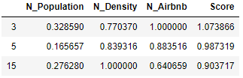
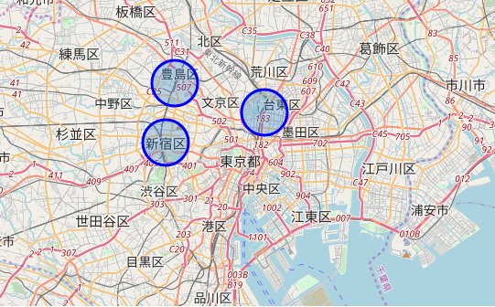
Population and density
Normalisation of key variables
Key variable are put into a normalised scale and the selection formula can be applied, the result identifies ward index 3, 5 and 15 as the top three scoring suburb.
The focus of the analysis is switched from ward to major district to refine recommended store location
Ward Index | Name | Major District
3 | Shinjuku | Shinjuku
5 | Taito | Ueno
15 | Toshima | Ikebukuro

Slide 8
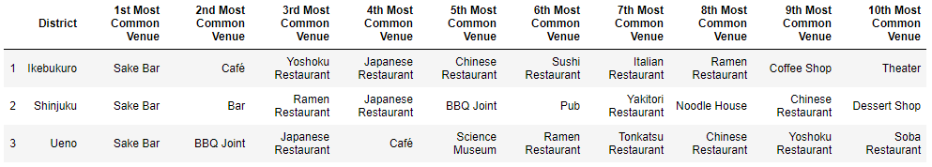
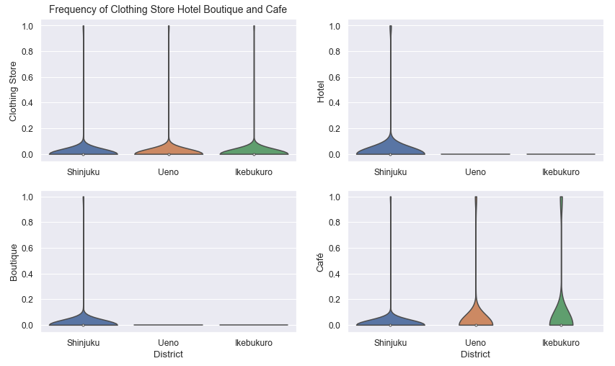
Entertainment Venues
Foursquare – All Venues
The venue location data from Foursquare API shows a strong present of entertainment business.
Looking at “Hotel”, “Café”, “Clothing Store” and “Boutique” categories in the venue data, there seems to be less hotels and boutiques in Taito and Toshima in comparison to Shinjuku

Slide 9
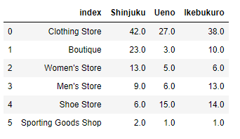
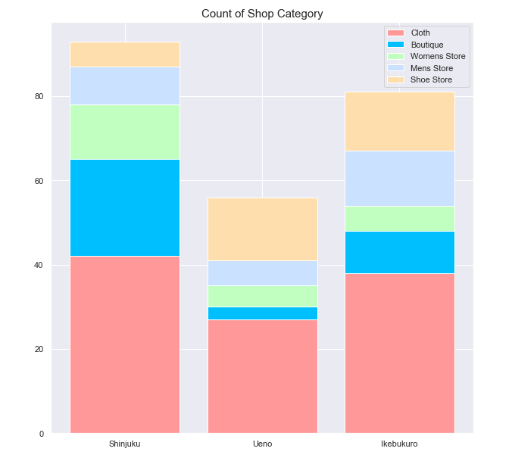
Fashion Venues
Foursquare – Fashion Venues
Venue data from Foursquare focusing in the Fashion Category, we see that Shinjuku is better established as a commercial hub for fashion shopping as both Taito and Toshima’s main district did not reach the number of venues we enquired for.
Shinjuku also has a higher portion of Cloth and Boutique stores.

Slide 10
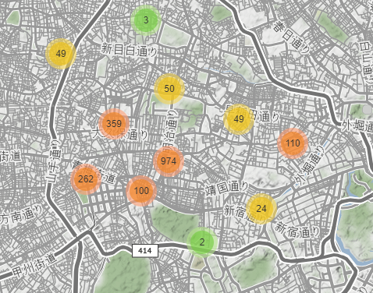
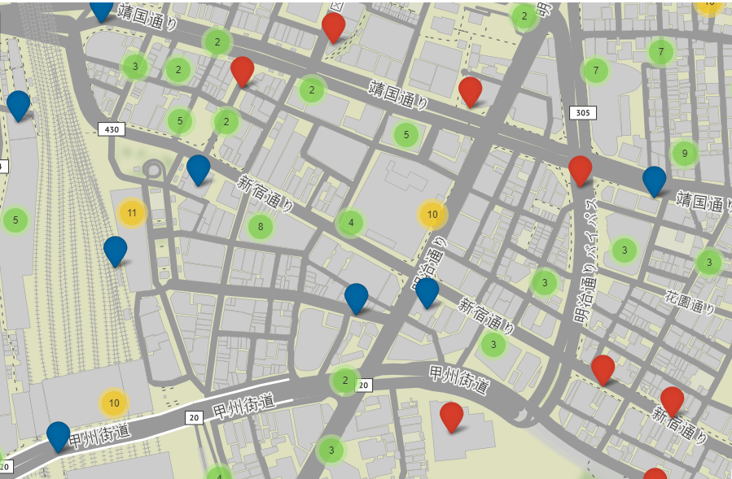
Conclusion
Recommendation
On the basis that Shinjuku obtained the highest score of 1.07 in the weighting formula and the evidence of established entertainment and fashion venues, the recommendation is to open the store in Shinjuku.
Location within Shinjuku with the highest concentration of location of interest:
Limitations
The limitation of this model is the number of venues returned by Foursquare

